Slide 1


Project No. 69
MEDISEARCH
www.medisearch.com

Slide 2

TEAM MEMBERS
Gayatri Gosavi
Rahul Kumar
Ujjawal Soni
211b122
211b239
211b333
Mentor: Dr. Prateek Pandey

Slide 3


CONTENTS
About MediSearch
Objective
Technology Stack
Features
Prototype images
Expected outcome
Team

Slide 4

ABOUT MEDISEARCH
Medisearch is a user-friendly, comprehensive website designed to empower individuals and families in their healthcare journey. Our intuitive platform lets you search for doctors by location and specialty, and even read patient reviews. We also offer a hassle-free appointment booking system, allowing you to schedule visits with your chosen healthcare providers effortlessly.

Slide 5
OBJECTIVE
Facilitate Access to Healthcare
Streamline Doctor Search
Offer Convenient Appointment Booking
Data Security and Privacy
Partnerships with Healthcare Providers

Slide 6





TECHNOLOGIES
TO BE USED
Front-end Development: HTML, CSS, JavaScript.
Back-end Development: A server-side scripting language like Node.js along with a web framework (Express.js).
Database Management: Relational database management systems (RDBMS) like MongoDB to store user data, doctor profiles, and appointments.

Slide 7
FEATURES
Doctor Search and Listings
Appointment Booking
Health Education Resources
User Accounts and Profiles
Emergency Services Information
Appointment History and Medical Records

Slide 8


EXPECTED OUTCOME
User-friendly Interface
Information Accessibility
Online Appointment making system
Mobile Responsiveness

Slide 9
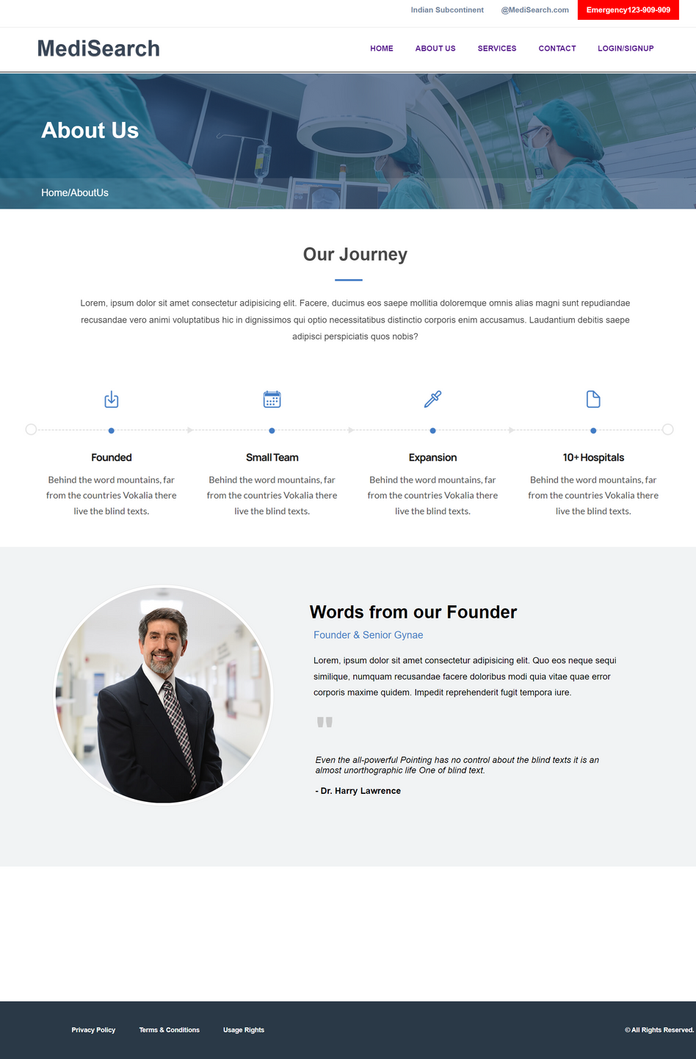

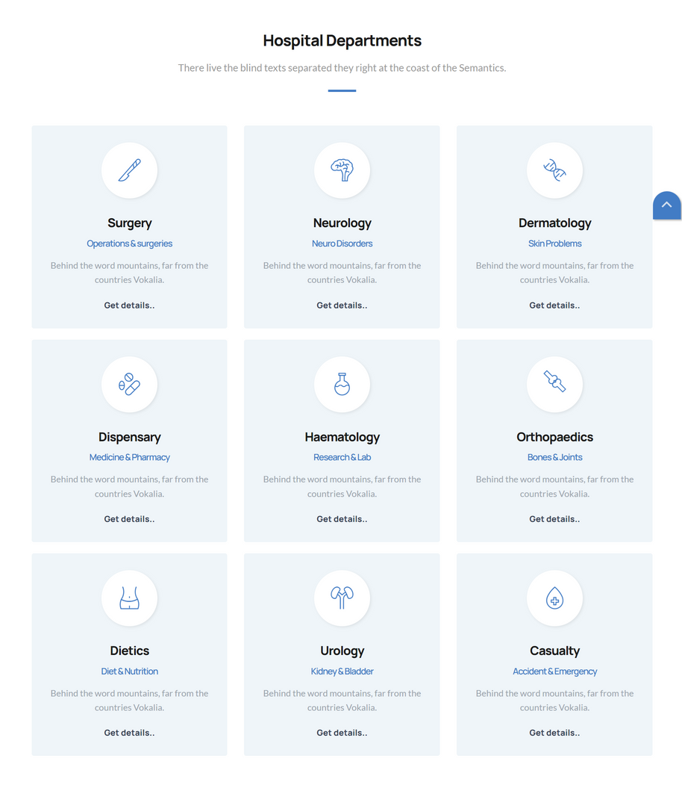
PROTOTYPE

Slide 10
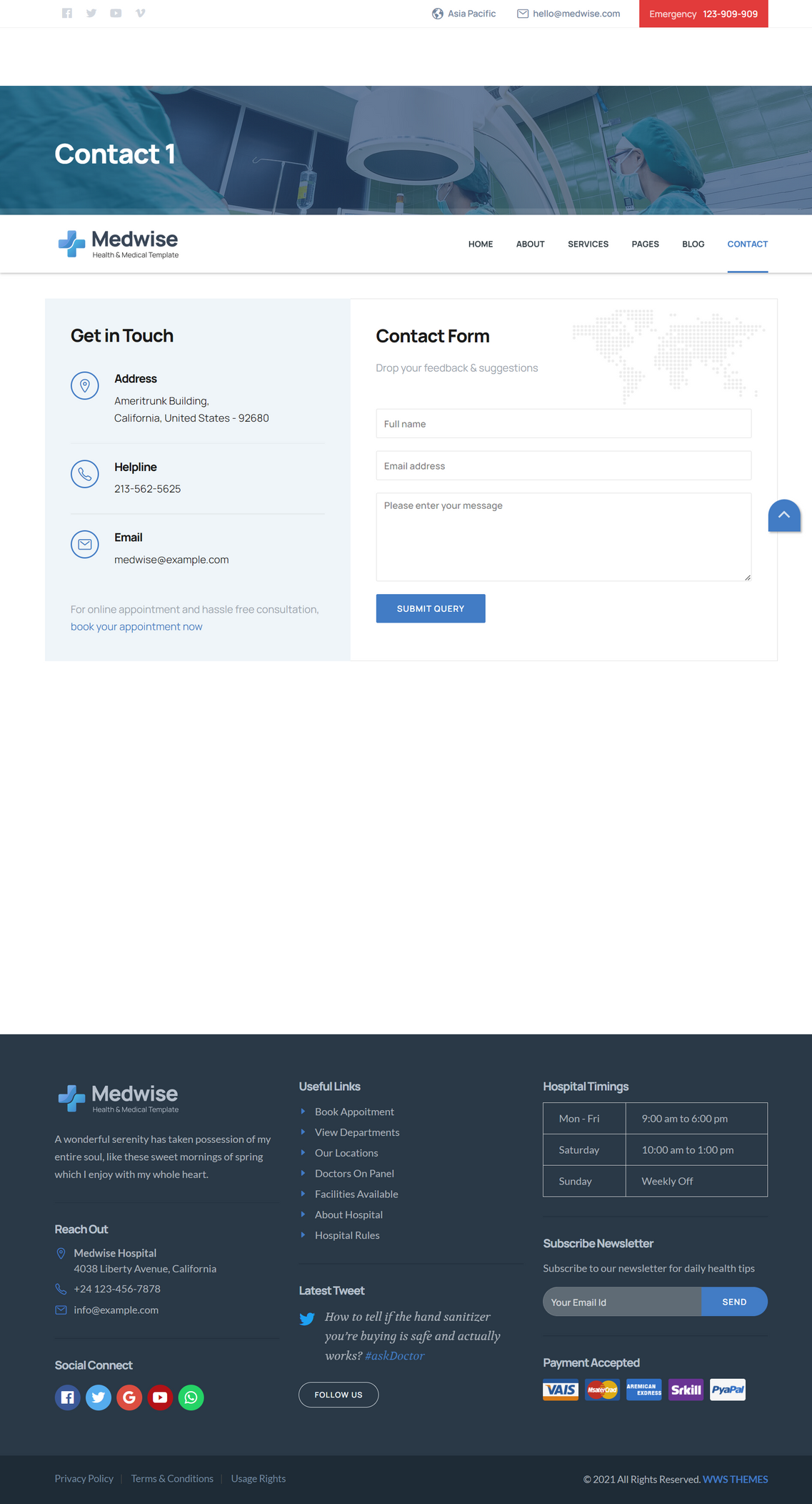
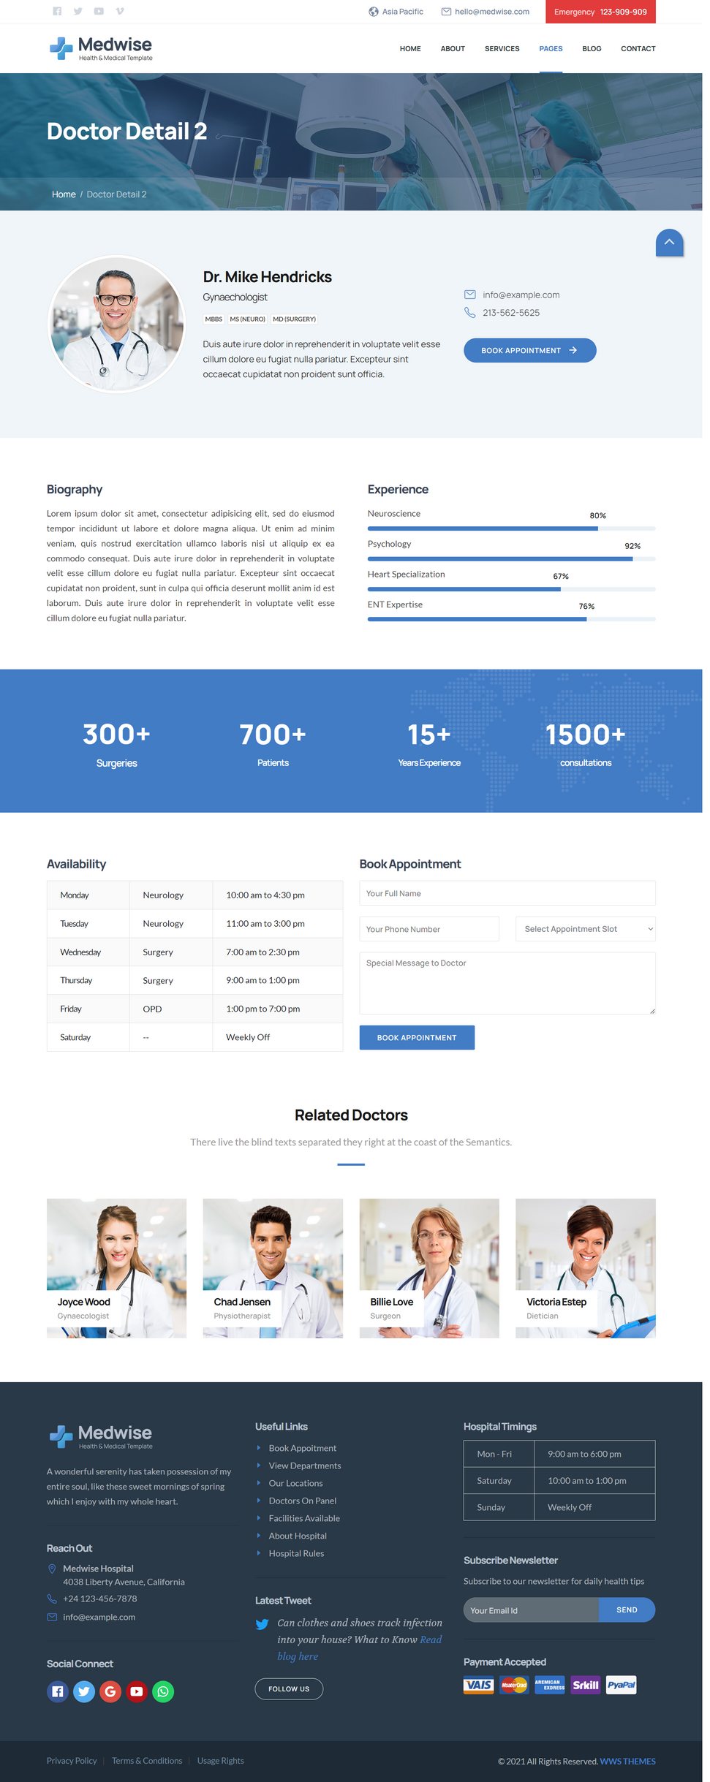
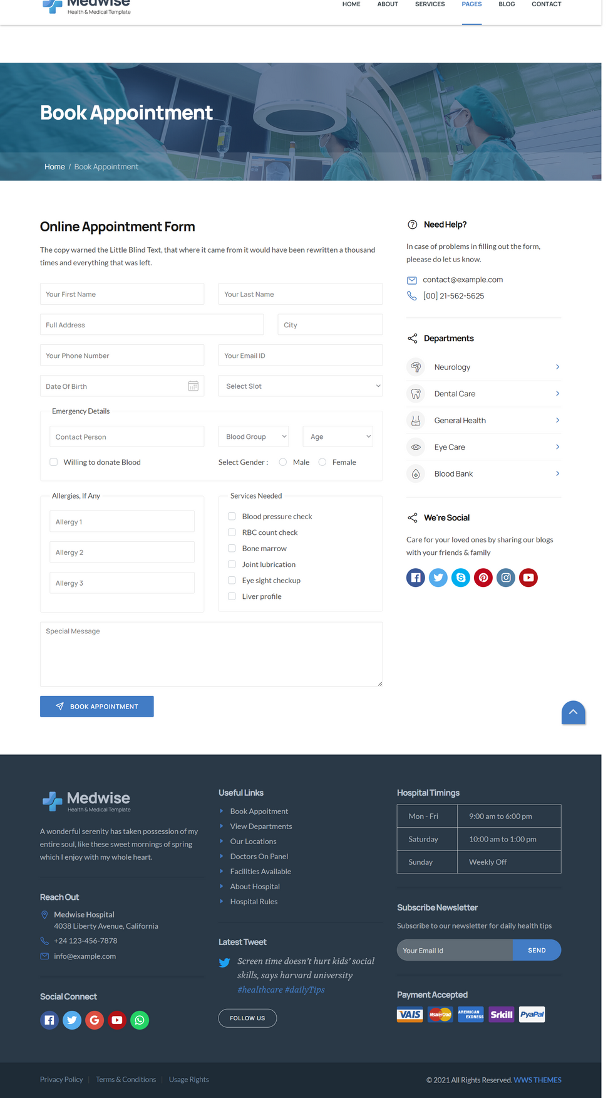
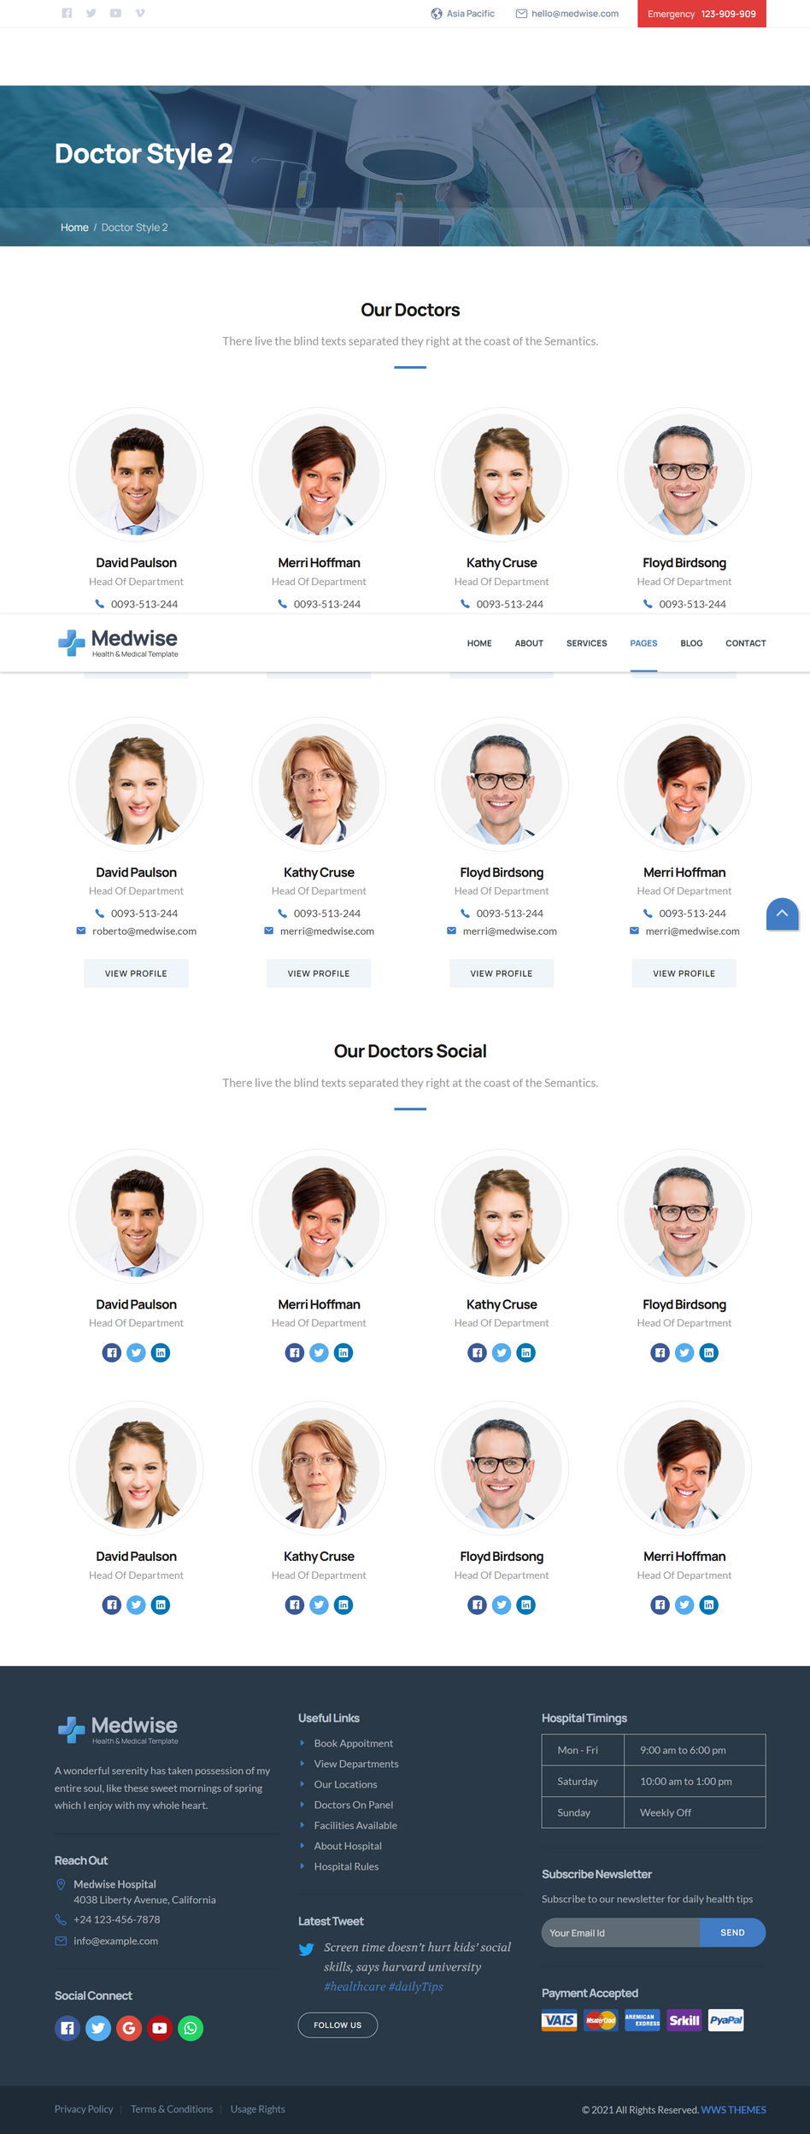
Doctor’s Profile

Slide 11
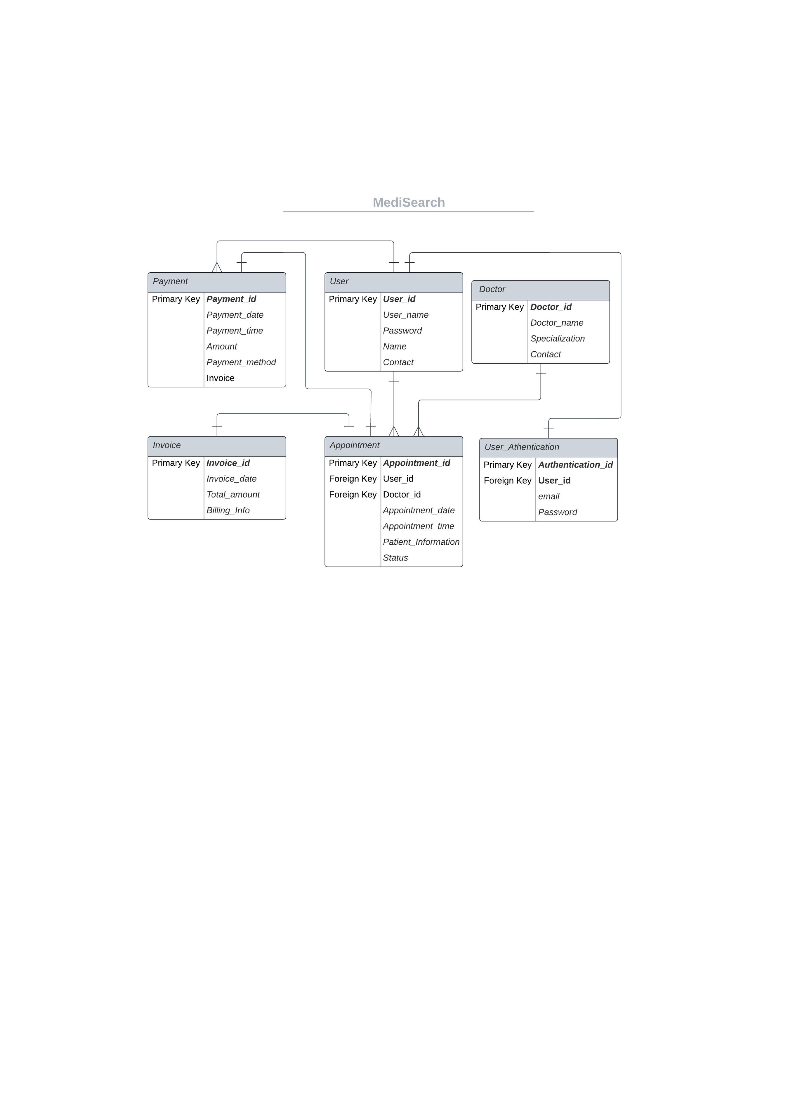
ER DIAGRAM
User makes Appointments (one-to-many)
Doctor has Appointments (one-to-many)
User makes Payments
(one-to-many)
Payment is associated with an Appointment
(one-to-one)
Payment is associated with an Invoice
(one-to-one)

Slide 12

Thank you !

